Slide 1
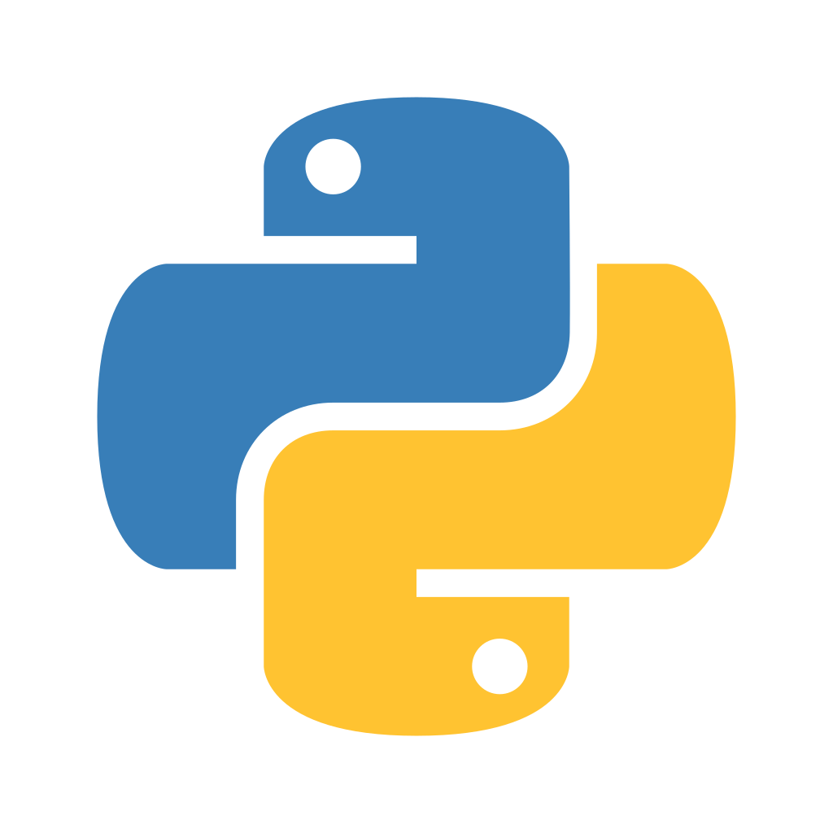




DAY-2
Python Basics, part 2

Slide 2



Instructor
From: Prodi Teknik Elektro, Institut Teknologi Bandung
Social Media:
Cynthia Evani
@cynthiaevani
Certification:
Google IT Automation with Python
Google Tensorflow Developer
AWS Certified Cloud Practitioner
Experience:
Machine Learning Student, Bangkit Academy (2021)
Machine Learning Engineer, PT Nomura Research Institute Indonesia (2021 - )
Cynthia Evani
DKI Jakarta

Slide 3
Classes & Objects

Slide 4
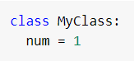
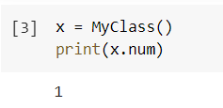
Class
Class is an object constructor, like a blueprint for creating objects.
Syntax:
Usage example:

Slide 5
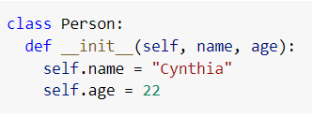
Function: __init__
__init__ is called automatically everytime the class is used to create a new object.
Used to assign values to object properties or other necessary operations.
Syntax:

Slide 6
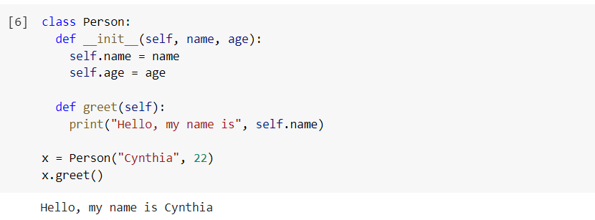
Example

Slide 7
Parameter: self
References the current instance of the class.
Used to access variables that belong to the class.
Has to be the first parameter of any function in the class.

Slide 8
Modules

Slide 9
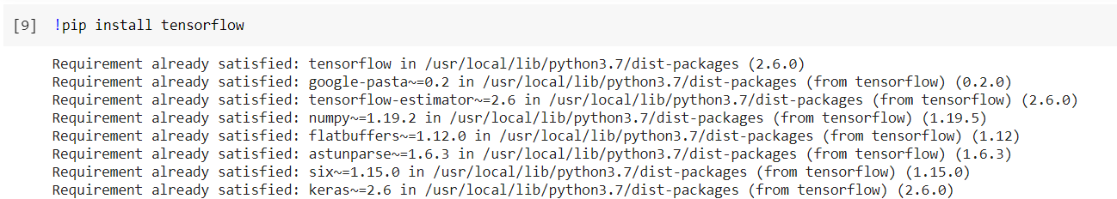
Module
Code library, contains functions you want to include in your code.
Open source libraries can be installed using pip
Note the ! before pip, this is used to indicate system-level command.

Slide 10
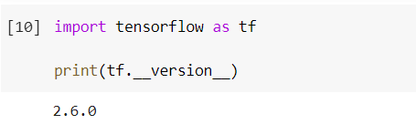
Module
To use a module, we need to import it first.

Slide 11
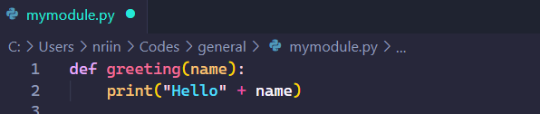
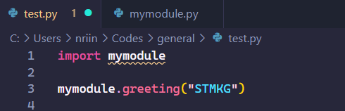
Module
We can also create our own module using Python script.
For example, we have a file named mymodule.py
We can use the module like

Slide 12
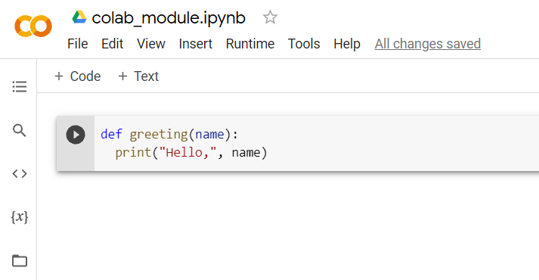
Custom Modules in Colab
For example, we have the following notebook.

Slide 13
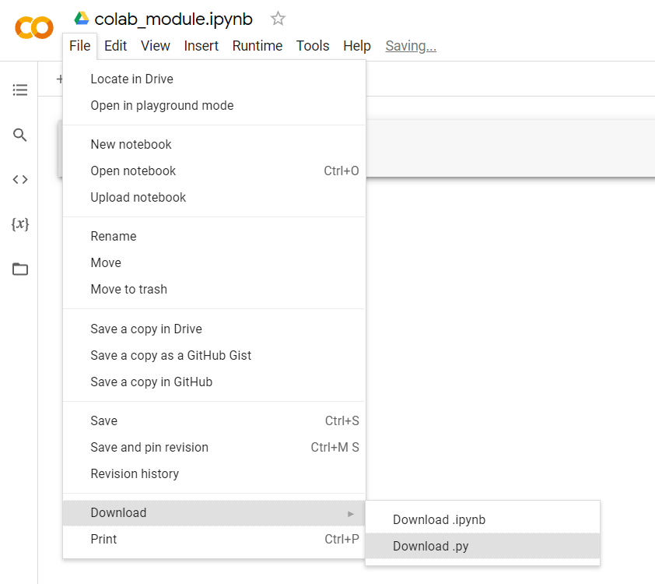
Custom Modules in Colab
You can download your notebooks as Python script.

Slide 14
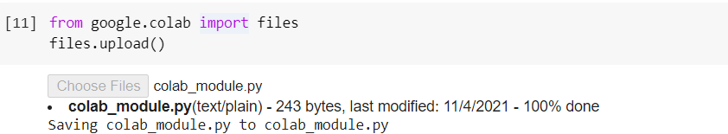
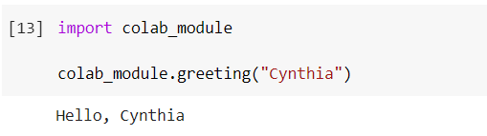
Custom Modules in Colab
Upload the script to your notebook.
Import and use the module

Slide 15
Try… Except...

Slide 16
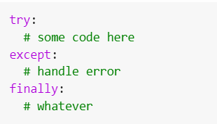
Try-Except-Finally
try lets you test a block of code for errors.
except lets you handle the error.
finally lets you execute code regardless of the result.
Syntax:

Slide 17
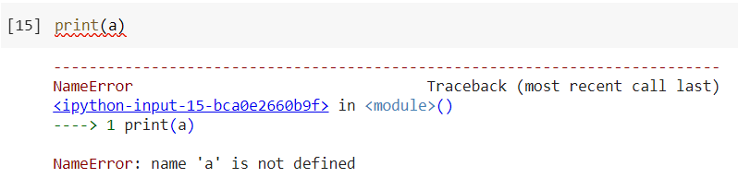
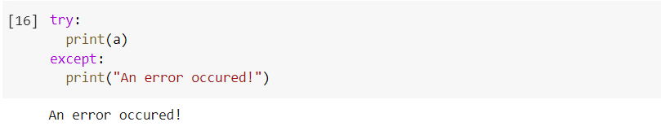
Examples
Undefined variable

Slide 18
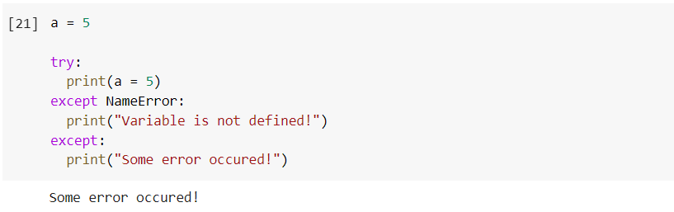
Examples
Handling special kind of exception

Slide 19
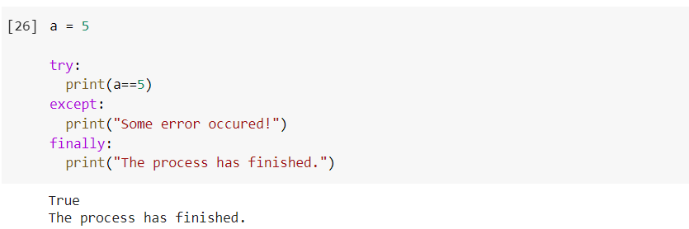
Examples
Finally

Slide 20
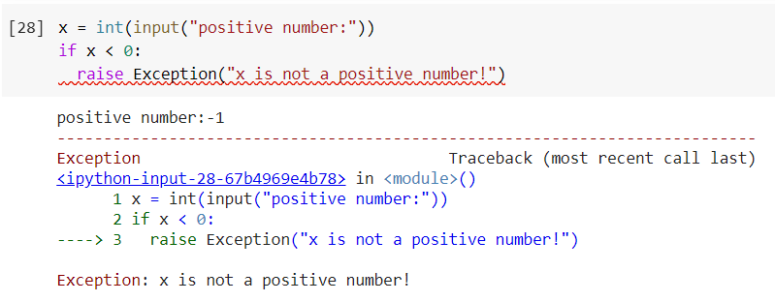
Raising Exception
You can throw an exception if a condition occurs.
Example:

Slide 21
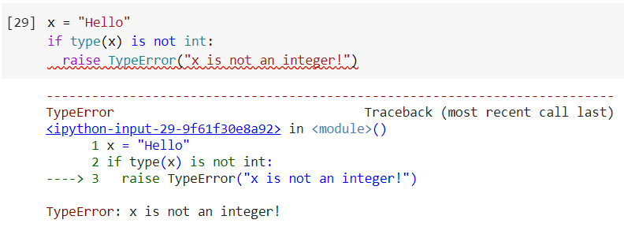
Raising Exception
Another example:
Error types: https://www.tutorialsteacher.com/python/error-types-in-python

Slide 22
File Handling

Slide 23
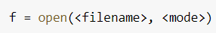
Function: open()
When working with files in Python, any file need to be opened first.
Syntax:
Available modes:
“r” - opens a file for reading (default)
“a” - opens a file for appending
“w” - opens a file for writing
“x” - creates the specified file
“t” - opens in text mode (default)
“b” - opens in binary mode, e.g. images

Slide 24
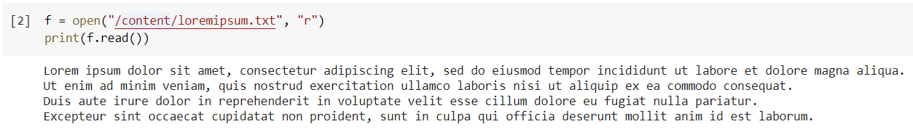
Reading a File
read()

Slide 25
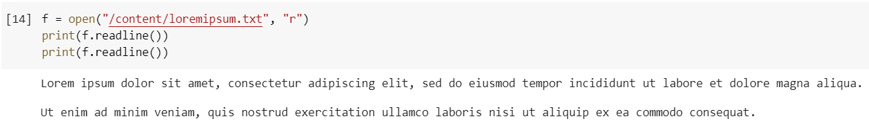
Reading a File
readline()

Slide 26
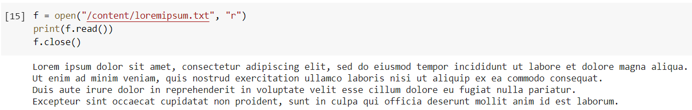
Function: close()
It’s good practice to always close the file after you’re done.
Too many opened files can slow down performance.
Changes may not go into effect until file is closed.
There is a limit of how many files can be opened.

Slide 27
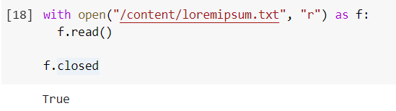
Function: close()
When you use with open(<filename>, <mode>) as <object>, Python automatically closes the file.

Slide 28
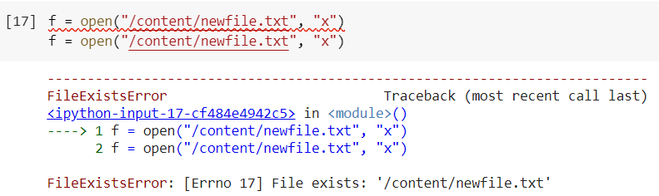
Creating a File
“x” mode will return an error if file already exists.
“a” and “w” mode will create a new file if the specified file does not exist.

Slide 29
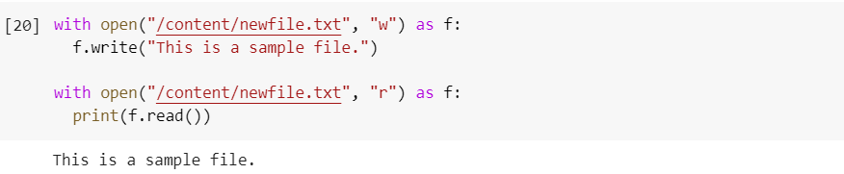
Writing to a File
For example, we have created this file and written a line.

Slide 30
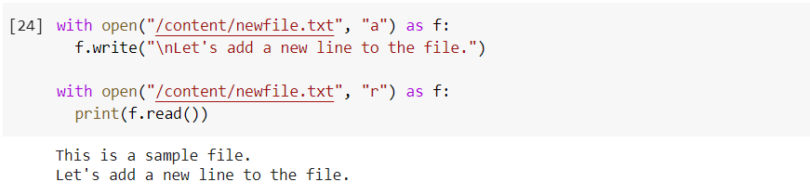
Writing to a File
To add lines, we use “a” mode.

Slide 31
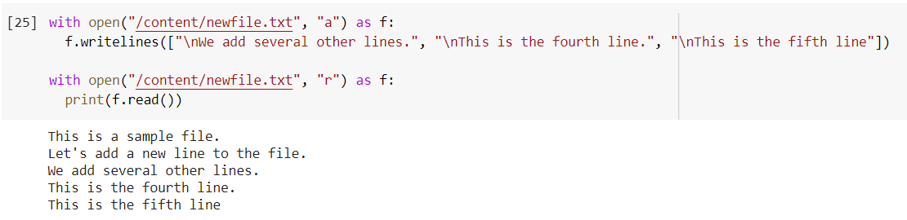
Writing to a File
writelines() to write multiple lines.

Slide 32
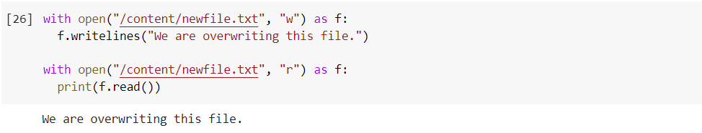
Writing to a File
When you use “w”, it overwrites the file.

Slide 33
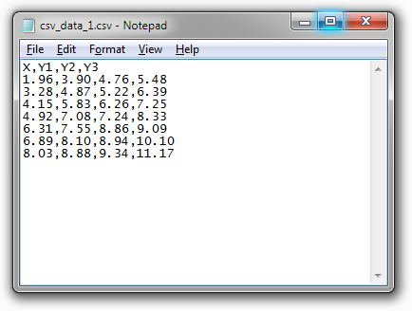
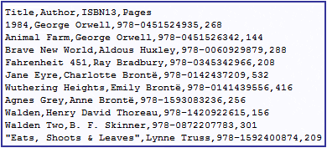
CSV Module
Used to create and read comma-separated values (CSV) files easily.
CSV format example:
https://peltiertech.com/open-csv-file-chart-csv-data/
https://www.progress.com/data-integration/data-sources/flat-file-formats/csv

Slide 34
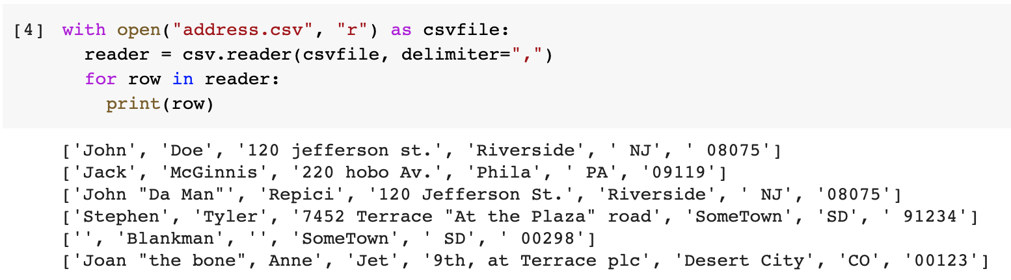
CSV Module
csv.reader()

Slide 35
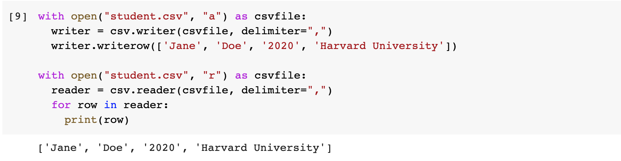
CSV Module
csv.writer()

Slide 36
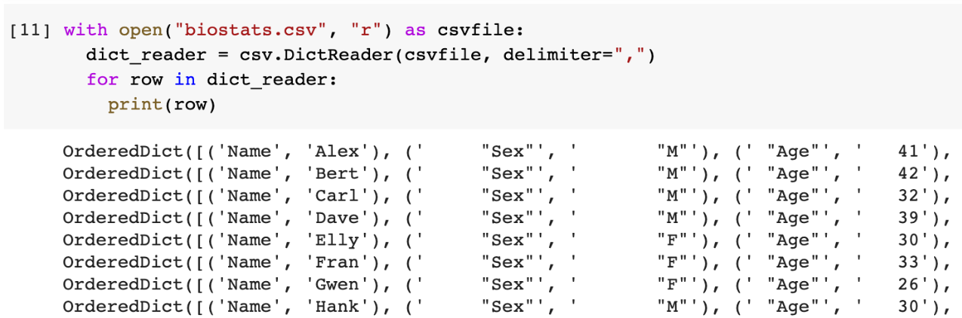
CSV Module
csv.DictReader()

Slide 37
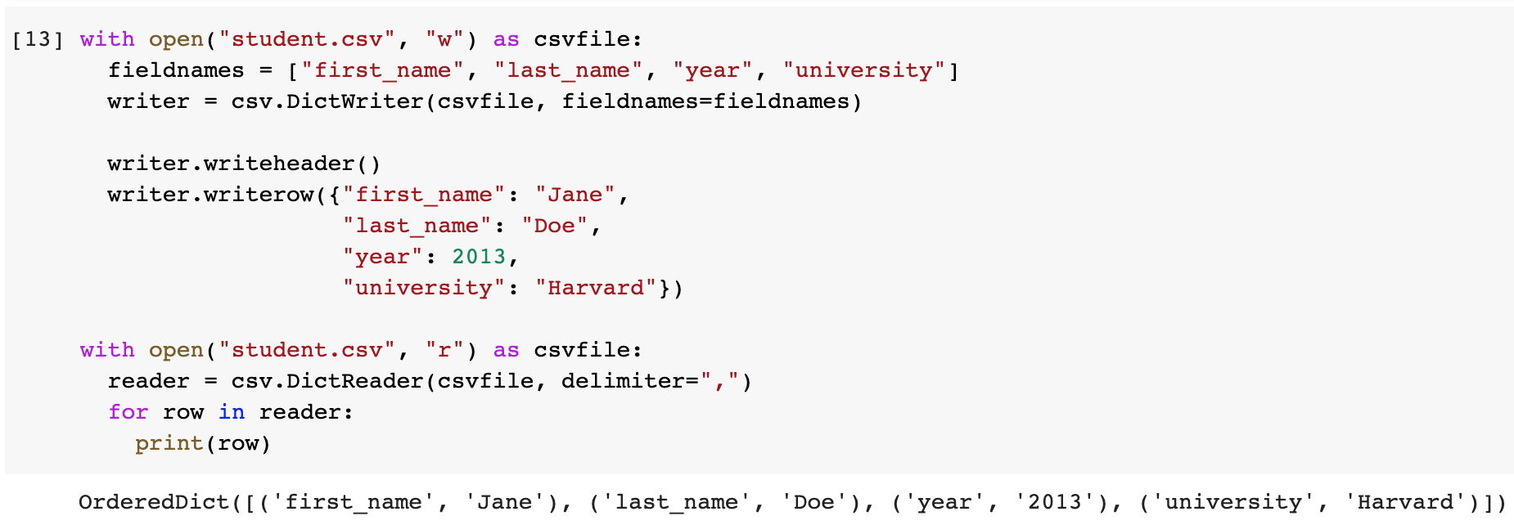
CSV Module
csv.DictWriter()

Slide 38
OpenCV Module
Used to work with image files.
Can be used to read and write image files and do operations.
Functions:
imread(): read an image file
shape(): get image size
resize(): change image size
cvtColor(): change image color

Slide 39
Pillow Module
Used to work with image files.
Can be used to read and write image files and do operations.
Functions:
open(): read an image file
size(): get image size
resize(): change image size
crop(): crop an image to specified size

Slide 40
Directories

Slide 41
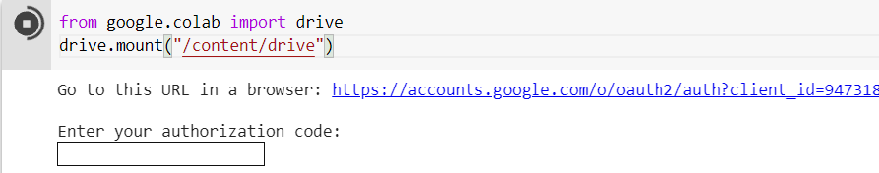
Mounting Google Drive
Since Google Colab is integrated with Google Drive, it makes sense to store our files in Drive instead of uploading it one by one to the notebook.
To access files in Drive, we need to mount it.
Files from Drive can now be accessed from the path /content/drive/MyDrive/...

Slide 42
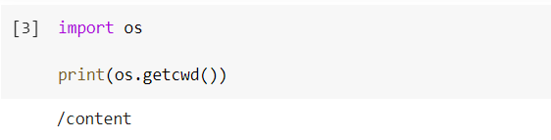
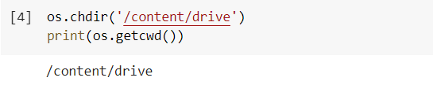
OS Module
Current working directory
Changing current directory

Slide 43
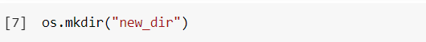
OS Module
Creating new directory
Using os.mkdir()
Will throw an error if specified directory already exists.
Can’t be used to create intermediate directory.

Slide 44
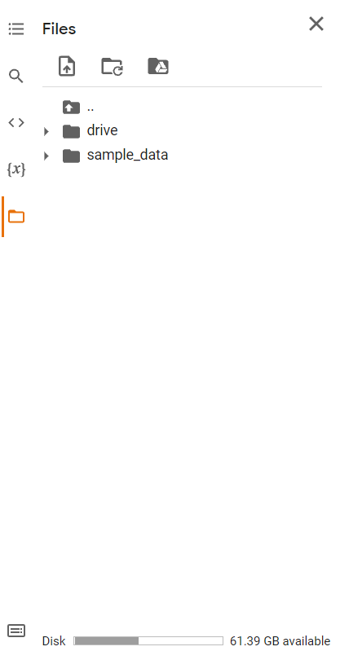
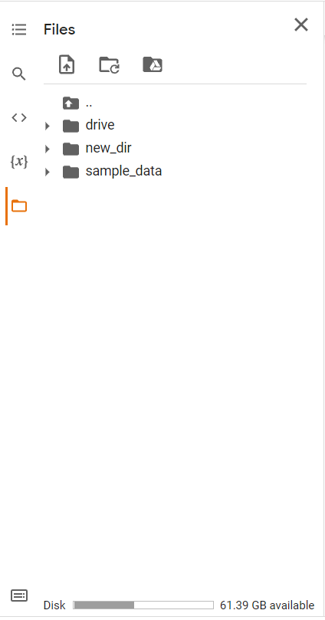
OS Module
before
after

Slide 45
OS Module
Creating new directory
Using os.makedirs()
Create directories recursively.
If exist_ok is set to True, will not throw an error if specified directory already exists.

Slide 46
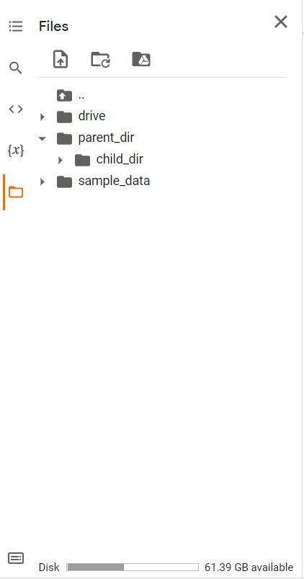
OS Module
before
after

Slide 47
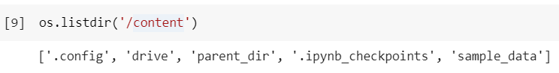
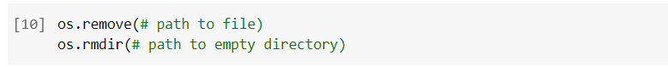
OS Module
Listing all files and directories in a path
Removing file or directory

Slide 48
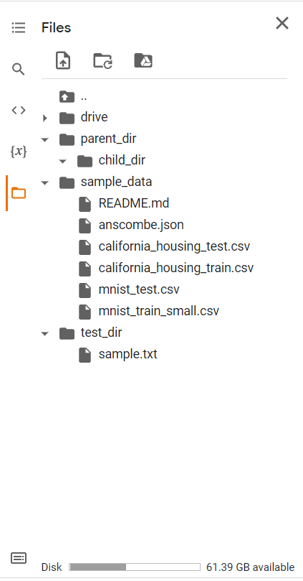
OS Path Module
For example, we have the following directories in the notebook.

Slide 49
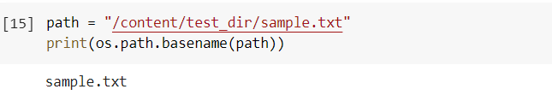
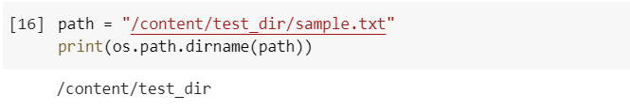
OS Path Module
os.path.basename()
os.path.dirname()

Slide 50
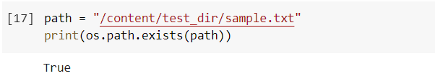
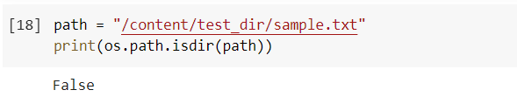

OS Path Module
os.path.exists()
os.path.isdir()
os.path.isfile()

Slide 51



OS Path Module
os.path.join()
os.path.split()
os.path.splitext()

Slide 52
RegEx

Slide 53


Regular Expression
A sequence of characters that forms a search pattern.
Used to check if a string contains the specified search pattern.
Built-in module in Python.
\
Functions:

Slide 54


Slide 55


Slide 56


Slide 57
References
https://www.w3schools.com/python
https://www.youtube.com/watch?v=rfscVS0vtbw
https://stackoverflow.com/questions/25070854/why-should-i-close-files-in-python
https://www.geeksforgeeks.org/os-module-python-examples/
https://docs.python.org/3/library/os.path.html

Slide 58


Thank You!

